Slide 1
UECS2103 Operating Systems

Slide 2
Contact
Mr. Sor Kean Vee
sorkv@utar.edu.my
016-2927502
Room: Level 8, FE33(1) Zone 1

Slide 3
Main Reference
Operating Systems: Internals and Design Principles, 8th Ed. William Stallings, Prentice Hall

Slide 4
Additional References
Operating System Design - The Xinu Approach. (2nd ed.). CRC Press. D. Comer. (2015).
Modern operating systems. (4th ed.). Pearson. Tanenbaum, A. S. (2014).

Slide 5
Assessment
Coursework 40%
Test 1 10%
Test 2 10%
Assignment 20%
Final exam 60%

Slide 6
Tools
Virtual machine
Vmware Workstation Player
Latest version: https://my.vmware.com/en/web/vmware/free#desktop_end_user_computing/vmware_workstation_player/12_0
Older version (Player 7): https://my.vmware.com/en/web/vmware/free#desktop_end_user_computing/vmware_player/7_0|PLAYER-714|product_downloads
VirtualBox
https://www.virtualbox.org/wiki/Downloads

Slide 7
Tools
Image file (iso). Examples:
https://www.ubuntu.com/download/desktop
https://elementary.io/
https://software.opensuse.org/422/en
https://getfedora.org/en/workstation/download/

Slide 8
Topics
Process Management
Scheduling
Memory Management
Secondary Storage Management
Security

Slide 9
Basic Elements
Processor (CPU)
Main Memory (RAM) referred to as real memory or primary memory
I/O modules – move data between computer and its external environment
System bus - provides communication among processors, memory, and I/O modules

Slide 10
Processor
PC : Program counter
IR : Instruction register
MAR : Memory address register
MBR : Memory buffer register
I/O AR : I/O address register
I/O BR : I/O buffer register

Slide 11
Processor
PC - Contains the address of an instruction to be fetched
IR - Contains the instruction most recently fetched
MAR - Specifies the address for the next read or write
MBR - Contains data written into memory or receives data read from memory
I/O address register – specifies a particular I/O device
I/O buffer register – for exchanging data between I/O module and the processor

Slide 12
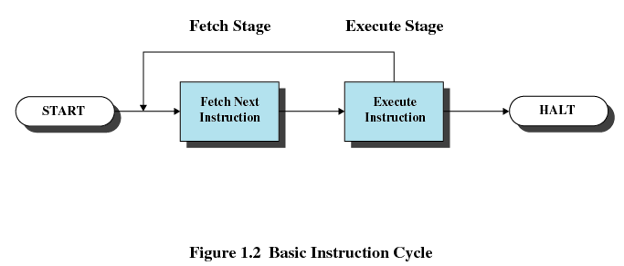
Instruction Execution
Two steps
Processor reads (fetches) instructions from memory (based on address stored in PC), one at a time, and placed in IR
Processor executes each instruction
Instruction cycle – the processing required for a single instruction

Slide 13
Instruction Execution
Action of an instruction can be categorised into
Processor-memory - transfer data between processor and memory
Processor-I/O - data transferred to or from a peripheral device
Data processing - arithmetic or logic operation on data
Control - alter sequence of execution

Slide 14
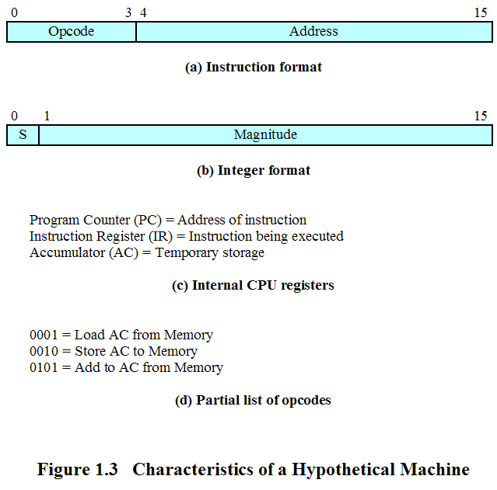
Instruction Execution - Example

Slide 15
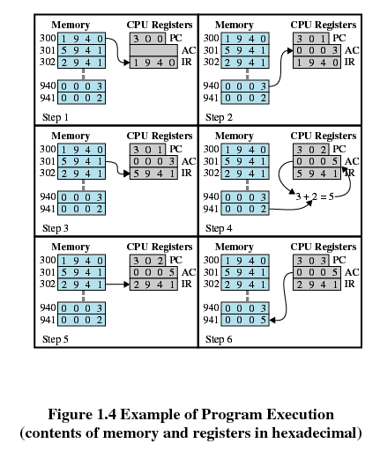
Instruction Execution - Example
PC (Program Counter) contains 300, address of 1st instruction (in hexadecimal, 1940). The instruction is loaded into the instruction register (IR) and the PC increased by 1)

Slide 16
Instruction Execution - Example
The 1st 4 bits (1st hexadecimal digit) indicate the AC to be loaded from memory (address 940, the remaining 12 bits or 3 hexadecimal digits)

Slide 17
Instruction Execution - Example
Next instruction (5941) fetched and PC incremented.
Old contents of AC and contents of location 941 are added and result stored in AC.

Slide 18
Instruction Execution - Example
Next instruction (2941) fetched and PC incremented.
Contents of AC are stored in location 941.

Slide 19
Interrupts
Interrupt the normal sequencing of the processor to improve the utilisation of processor
Most I/O devices are slower than the processor
Processor must pause to wait for device

Slide 20
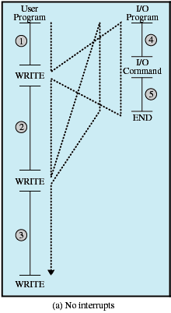
Interrupts
Program flow without interrupt

Slide 21
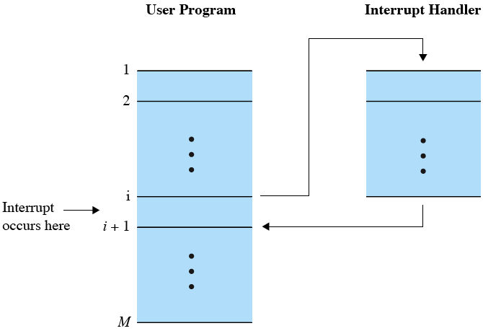
Interrupts
Program flow with interrupt

Slide 22
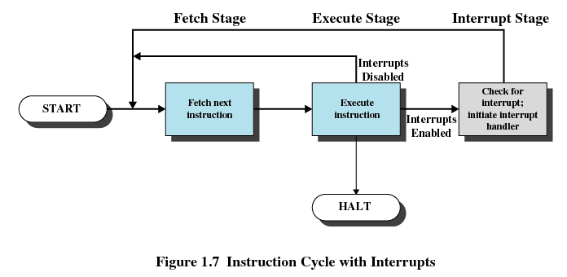
Interrupts
Processor checks for interrupts
If no interrupts, fetch the next instruction for the current program
If an interrupt is pending, suspend execution of the current program, and execute the interrupt-handler routine

Slide 23
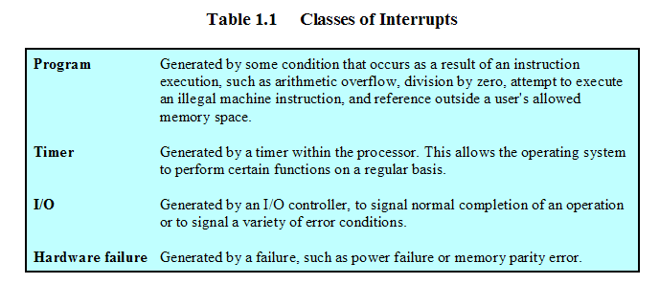
Interrupts
Interrupts classes

Slide 24
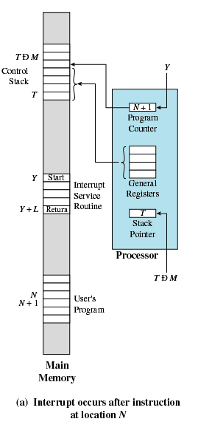
Interrupts
Occurs after instruction at location N

Slide 25
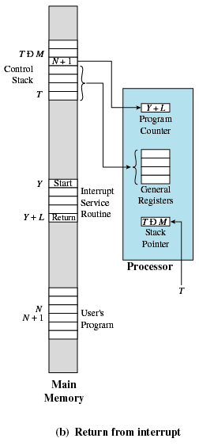
Interrupts
Return from interrupt

Slide 26
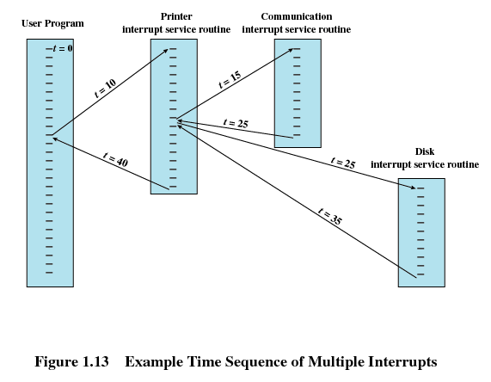
Interrupts
Multiple interrupts
Priority: printer < disk < comm. line

Slide 27
Operating System
A program that controls the execution of application programs
An interface between applications and hardware
Exploits the hardware resources of one or more processors
Provides services to system users
Manages secondary memory and I/O devices

Slide 28
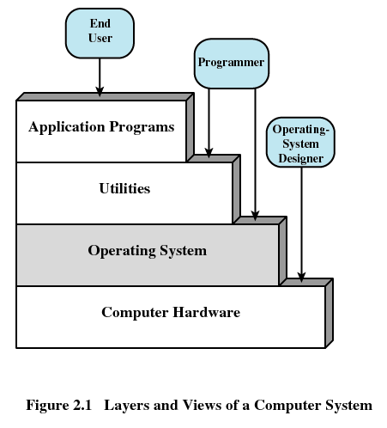
Operating System

Slide 29
Operating System
Kernel
Portion of operating system that is in main memory
Contains most frequently used functions
Also called the nucleus

Slide 30
Operating System
Server operating system
Real-time operating system
Embedded operating system
Robot operating system
…

